Slide 1
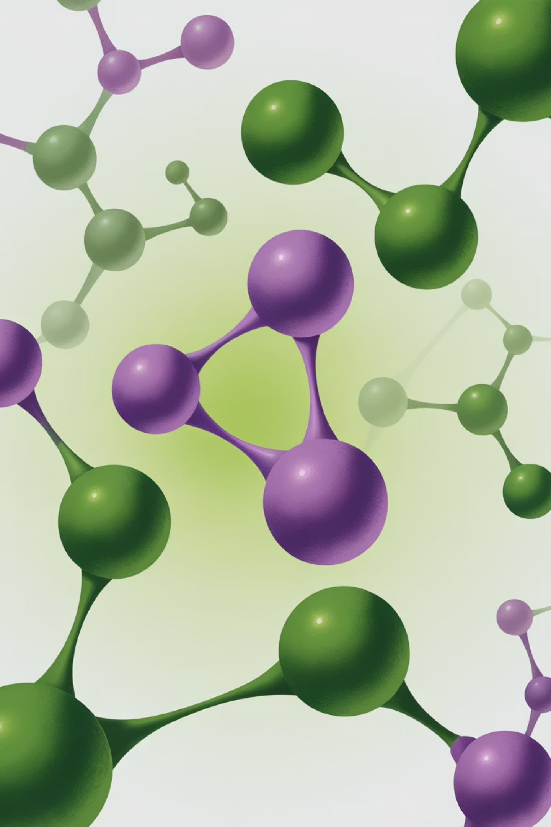


Radiation-Enhanced Antimicrobial Properties of Cationic Porphyrins
NPRM 2025 Conference
Lusine Aloyan
Alikhanyan National Science Laboratory (Yerevan Physics Institute)
Yerevan State University

Slide 2
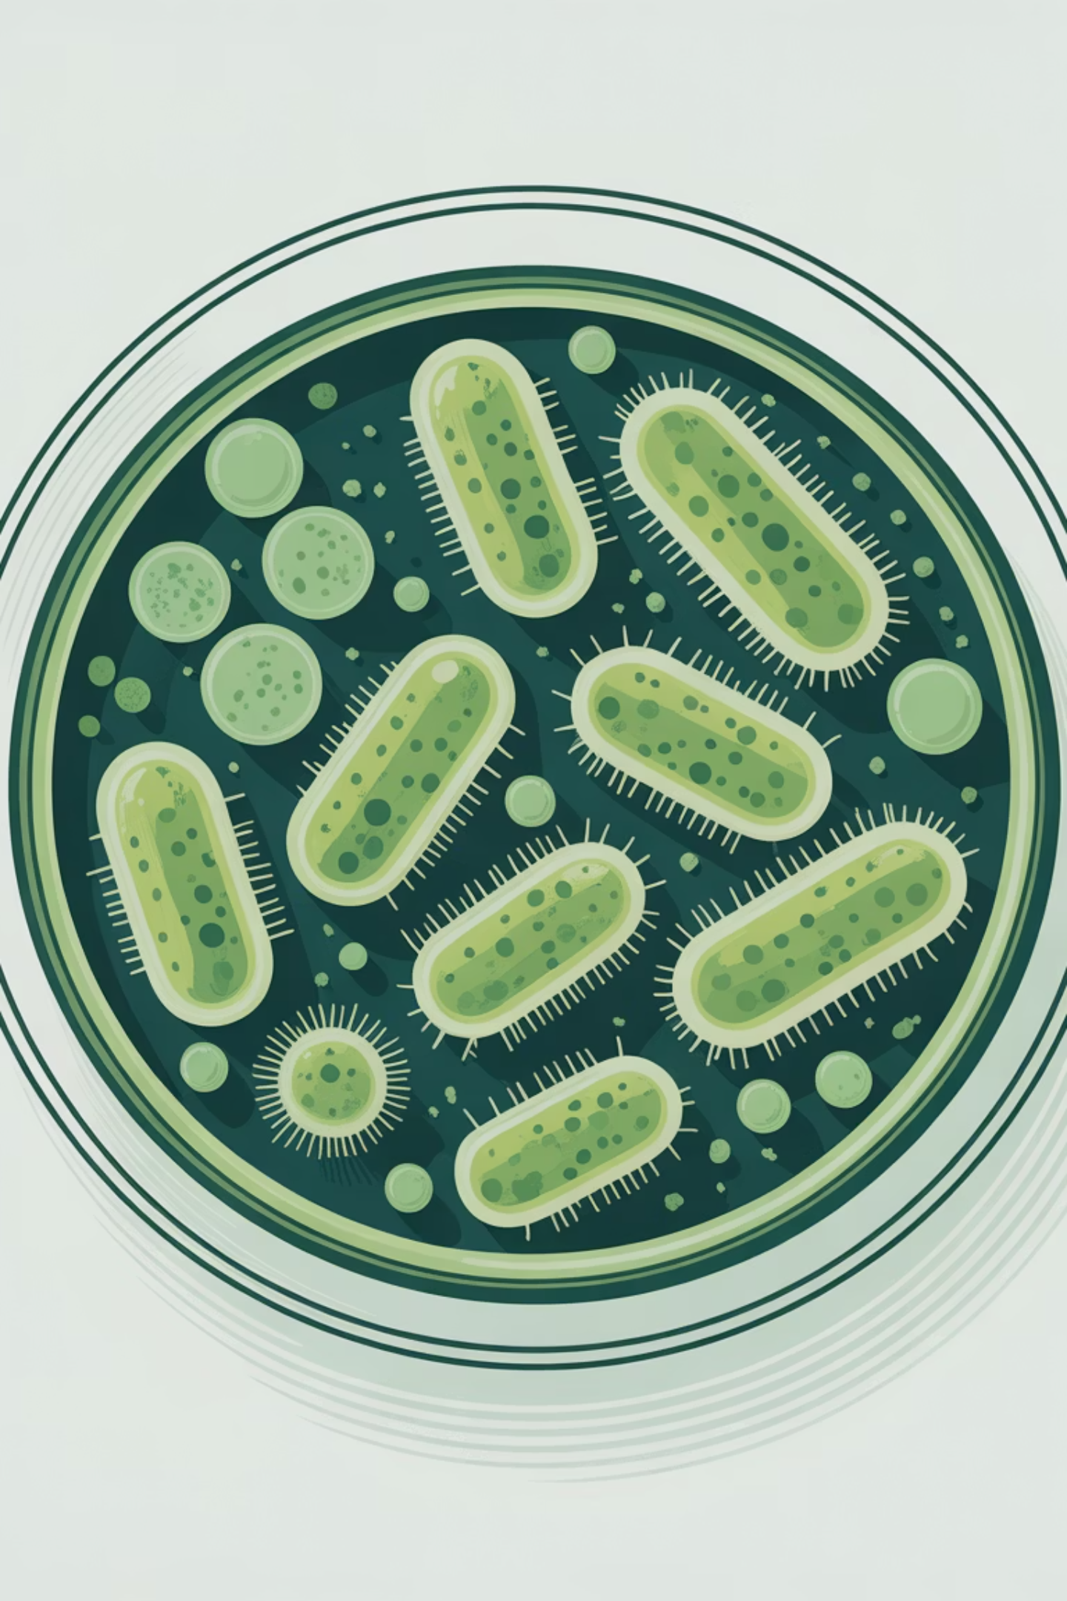
Introduction: The Global AMR Crisis
The Challenge
Our Approach: Dual-Mode Strategy
Multidrug-resistant bacteria represent one of the most pressing threats to global healthcare systems. Conventional antibiotics are becoming increasingly ineffective, with 2-3 million infections occurring annually from resistant strains. The clinical and economic burden is staggering, driving urgent demand for alternative therapeutic approaches.
Photodynamic therapy: Light-activated antimicrobial action through reactive oxygen species generation
Radiation enhancement: Ionising radiation for targeted DNA damage amplification
Combined synergy: Superior efficacy without resistance development potential
Traditional antimicrobial strategies face diminishing returns as bacterial adaptation accelerates faster than drug development pipelines can respond.
This innovative dual-mode strategy leverages cationic porphyrins as versatile agents capable of both photosensitisation and radiosensitisation.
Notes:
Сегодня мы сталкиваемся с глобальным кризисом антимикробной резистентности. Мультирезистентные бактерии представляют одну из наиболее серьёзных угроз для систем здравоохранения во всём мире. Традиционные антибиотики становятся всё менее эффективными — ежегодно регистрируется 2-3 миллиона инфекций, вызванных резистентными штаммами. Клиническое и экономическое бремя колоссально, что создаёт острую необходимость в поиске альтернативных терапевтических подходов.
Традиционные антимикробные стратегии демонстрируют снижающуюся эффективность, поскольку бактериальная адаптация происходит быстрее, чем разработка новых лекарственных препаратов.
Наш подход основан на двухрежимной стратегии, которая включает:
Фотодинамическую терапию — светоактивируемое антимикробное действие через генерацию активных форм кислорода
Радиационное усиление — ионизирующее излучение для направленной повреждений ДНК
Комбинированную синергию — превосходную эффективность без потенциала развития резистентности
использование катионные порфирины как универсальные агенты, способные к фотосенсибилизации и радиосенсибилизации одновременно.

Slide 3

Cationic Porphyrins: Structure & Properties
Our Porphyrin Library
Metal Complexes Studied
meso-Tetra(4-N-pyridyl)porphyrins with variable R-groups:
Metals: 2H (free base), Zn(II), Cu(II), Co(III), Mn(III), Au(III), Ag(I)
TMPyP (R = CH₃): Methyl substituent providing baseline hydrophobic character
Cationic charge: +4 on peripheral pyridinium groups conferring exceptional water solubility and electrostatic affinity for negatively charged bacterial surfaces and DNA phosphate backbone
TOEtPyP (R = CH₂-CH₂-OH): Hydroxyethyl substituent enhancing hydrogen bonding capacity
TAlPyP (R = CH₂-CH=CH₂): Allyl substituent with unsaturated functionality
Water-soluble: Excellent bioavailability without organic solvents, enabling direct biological application
TMetAlPyP (R = CH₂-C(-CH₃)=CH₂): Methallyl substituent for steric modulation
TButPyP (R = CH₂-CH₂-CH₂-CH₃): Butyl substituent extending lipophilic interactions
The cationic nature provides selective accumulation in bacterial cells over mammalian cells due to membrane potential differences.
Each structural variant modulates DNA binding affinity, cellular uptake kinetics, and photophysical properties critical for therapeutic applications.
Notes:
Библиотека порфиринов, которую мы исследовали достаточно широкая

Slide 4
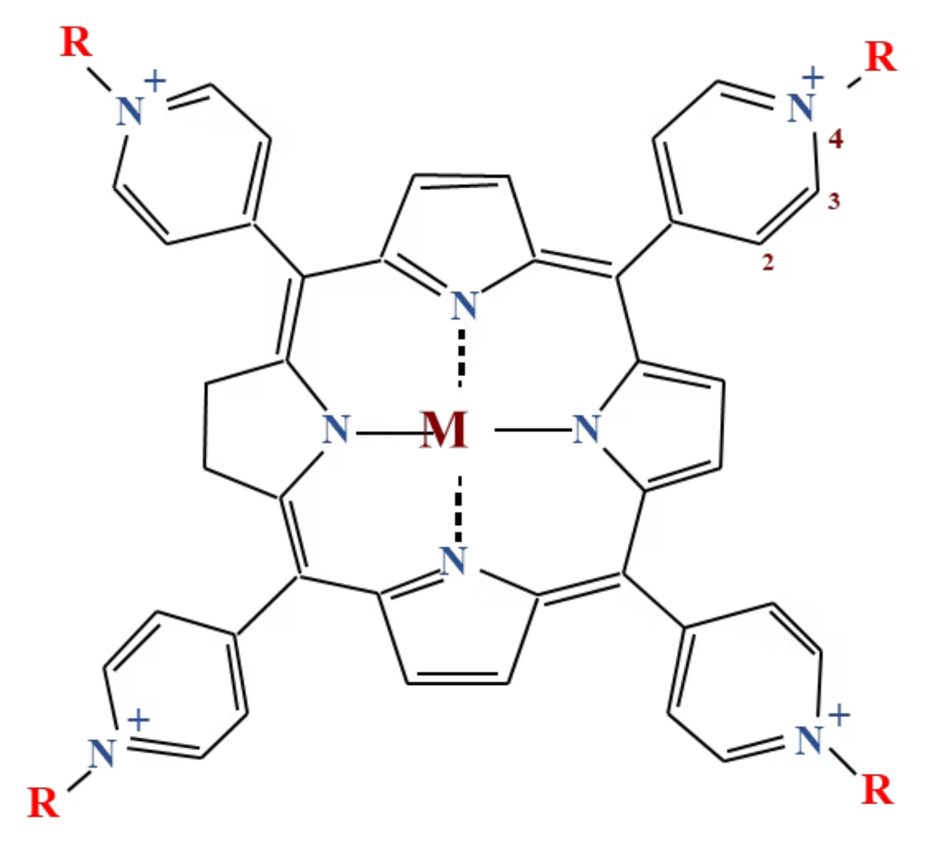
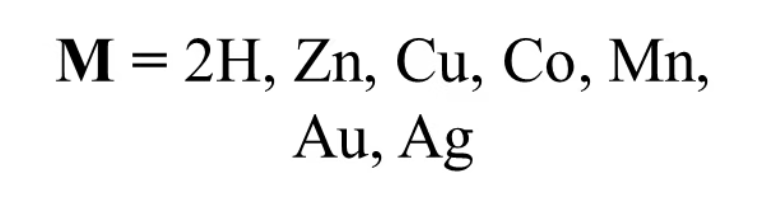
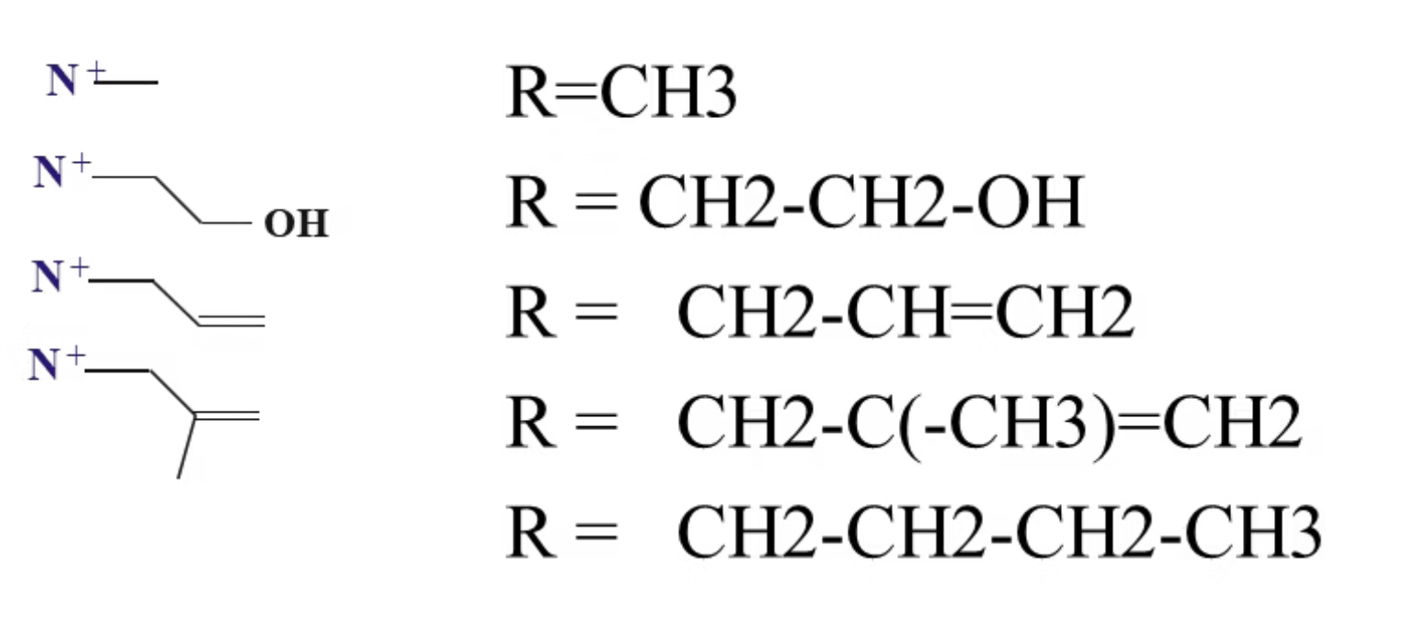
Notes:
Ключевые характеристики:
Катионный заряд +4 на периферических пиридиниевых группах обеспечивает исключительную растворимость в воде и электростатическое сродство к отрицательно заряженным бактериальным поверхностям и фосфатному остову ДНК
Водорастворимость — отличная биодоступность без органических растворителей, позволяющая прямое биологическое применение
Важно отметить, что катионная природа обеспечивает селективное накопление в бактериальных клетках по сравнению с клетками млекопитающих благодаря различиям в мембранном потенциале.

Slide 5

DNA Binding Modes of Cationic Porphyrins
Understanding how cationic porphyrins interact with bacterial DNA is fundamental to elucidating their antimicrobial mechanisms. These molecules exhibit remarkable versatility in their binding behaviour, adopting multiple interaction modes depending on concentration, ionic strength, and DNA sequence context.
Intercalation
External Stacking
Groove Binding
Porphyrin ring inserts between DNA base pairs through strong π-π stacking interactions. This causes significant DNA helix unwinding (26-30°) and lengthening, disrupting normal replication and transcription processes. Requires specific geometric constraints.
Porphyrin stacks on DNA surface via electrostatic attraction to phosphate groups whilst maintaining helical integrity. Characterised by rapid association/dissociation kinetics, enabling dynamic equilibrium. Predominates at intermediate ionic strengths.
Localisation in major or minor grooves through electrostatic interactions with phosphate backbone and hydrogen bonding with bases. Exhibits sequence-specific preferences for A-T or G-C rich regions, influencing selectivity.
Investigated by: UV/Vis spectroscopy (hypochromism, bathochromism), Circular dichroism (induced CD signals), Microcalorimetry (thermodynamic parameters), providing comprehensive binding characterisation.

Slide 6
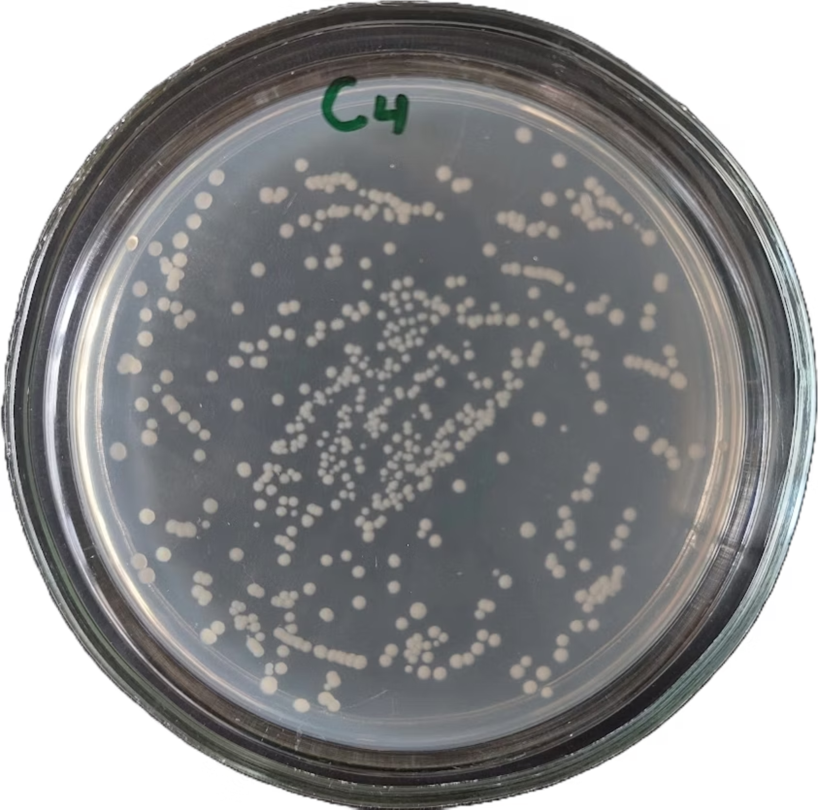
Photodynamic Antimicrobial Activity
Experimental Design: TAlPyP4 vs. E. coli
Material & Methods
Experimental Groups
Organism: Wild-type Escherichia coli as representative Gram-negative pathogen
Control: Bacterial suspension without porphyrin treatment, establishing baseline viability
Growth conditions: Nutrient agar, 37°C, 18-24 hours to exponential phase
Dark cytotoxicity: Porphyrin added with no light exposure, testing intrinsic antimicrobial activity
Working suspension: ~10,000-fold dilution in phosphate buffered saline (PBS)
Photodynamic treatment: Porphyrin plus blue light irradiation, evaluating photosensitised killing
Porphyrin: meso-tetra(4-N-allylpyridyl)porphyrin (TAlPyP4)
Colony forming units (CFU) counted after 24-hour incubation on nutrient agar to quantify viable bacteria.
Concentration ratio: 500:1 (porphyrin:bacteria molar ratio)
Light source: Blue light at 460 nm matching Soret band absorption
Irradiation time: 30 minutes with intensity monitoring

Slide 7
Photodynamic Results: TAlPyP4 Performance
60%
>99%
Dark Cytotoxicity
Photodynamic Activity
Bacterial inactivation without light activation, demonstrating intrinsic antimicrobial activity
Bacterial inactivation with 460 nm light exposure for 30 minutes
Key Findings
The substantial dark cytotoxicity (~60% bacterial inactivation) indicates that cationic charges on the porphyrin periphery disrupt bacterial membrane integrity even without photoactivation. This electrostatic interaction destabilises the lipopolysaccharide layer in Gram-negative bacteria, causing increased membrane permeability and cell death.
Upon light activation at 460 nm, TAlPyP4 demonstrates superior photosensitiser performance with >99% bacterial inactivation. Light absorption at the Soret band triggers intersystem crossing to the triplet state, which then transfers energy to molecular oxygen generating reactive oxygen species.
Mechanism of Action
Light Absorption
Triplet Formation
460 nm excitation at Soret band maximum
Intersystem crossing from excited singlet state
ROS Generation
Multi-target Damage
Singlet oxygen, superoxide, hydroxyl radicals
Oxidation of membranes, proteins, DNA, lipids
Notes:
Результаты впечатляют:
Тёмная цитотоксичность: 60% инактивации бактерий без световой активации
Фотодинамическая активность: >99% инактивации с облучением светом 460 нм в течение 30 минут
Ключевые находки:
Существенная тёмная цитотоксичность (~60%) указывает, что катионные заряды на периферии порфирина нарушают целостность бактериальной мембраны даже без фотоактивации. Это электростатическое взаимодействие дестабилизирует липополисахаридный слой грамотрицательных бактерий.
При световой активации TAlPyP4 демонстрирует превосходные характеристики фотосенсибилизатора с >99% инактивацией бактерий.

Slide 8
Ionising Radiation: Mechanisms & DNA Damage
Radiation-Induced DNA Damage Pathways
Direct Action (~20% of damage)
Indirect Action (~80% of damage)
Direct ionisation of DNA molecules occurs when radiation energy is deposited directly into the DNA structure. Energy deposition from electrons liberated during ionisation events causes immediate strand breaks and base damage. This pathway is independent of the cellular environment and occurs at a rate proportional to radiation dose.
Water radiolysis represents the dominant mechanism: H₂O → •OH, e⁻ₐq, H•, H₂O₂. Free radicals generated from water then attack DNA in chemical reactions occurring within nanoseconds to microseconds post-irradiation.
The hydroxyl radical (•OH) is particularly damaging due to its high reactivity and diffusion capacity, creating an amplified damage cascade throughout the cellular environment.
The efficiency of direct action increases with higher linear energy transfer (LET) radiation such as alpha particles or heavy ions.
Types of DNA Damage
1
2
Single-Strand Breaks (SSBs)
Double-Strand Breaks (DSBs)
One DNA backbone break, readily repaired by base excision repair pathways
Both backbones broken, most lethal lesion requiring complex repair mechanisms
3
4
Base Modifications
DNA-Protein Crosslinks
Oxidation and deamination of nucleotide bases altering coding properties
Covalent bonds between DNA and associated proteins blocking replication
Notes:
Теперь обратимся к радиационной части нашего исследования.
Механизмы радиационно-индуцированного повреждения ДНК
Существуют два основных пути:
Прямое действие (~20% повреждений) — прямая ионизация молекул ДНК происходит при непосредственном осаждении энергии излучения в структуру ДНК. Это вызывает немедленные разрывы цепей и повреждение оснований.
Непрямое действие (~80% повреждений) — радиолиз воды представляет доминирующий механизм. Свободные радикалы, генерируемые из воды, затем атакуют ДНК. Гидроксильный радикал особенно повреждающий благодаря высокой реактивности.

Slide 9
AREAL Facility: Electron Beam Irradiation
Advanced Research Electron Accelerator Laboratory
Technical Specifications
Advantages
Type: Electron linear accelerator (photocathode RF gun) providing exceptional beam quality
Ultra-short interaction time: Sub-picosecond pulses enable investigation of primary radiation chemistry processes before thermal equilibration
Beam energy: 3-5 MeV, optimal for biological sample irradiation with controlled penetration depth
Sufficient radiation dose: Accumulated dose delivery through repeated pulses whilst maintaining sample integrity
Bunch length: ~0.5 ps (sub-picosecond) enabling investigation of ultra-fast radiation chemistry
Pulse duration: 500 fs (femtosecond) temporal resolution
Precise dose control: Monitored through Faraday cup and dosimetry protocols
Frequency: 5 Hz repetition rate for dose accumulation control
Particle charge: Up to 800 pC per bunch delivering precise dose increments
Out-of-vacuum extraction: Samples irradiated in physiological conditions
Configuration: Two experimental stations for in-air irradiation without vacuum requirements
Notes:
Для облучения электронным пучком образцов мы использовали установку AREAL — Лабораторию передовых исследований электронного ускорителя.
В Институте прикладных проблем физики академии наук проводилич облучения рентгеновскими пучками

Slide 10
DNA Melting Studies: Radiation Sensitivity
Methodology: Thermal Denaturation Analysis
DNA melting curve analysis provides a sensitive probe of double helix structural integrity. The thermal denaturation transition from ordered double helix to random coil single strands occurs over a characteristic temperature range, with parameters that reflect DNA stability and structural perturbations.
Principle
Parameters Measured
System Studied
DNA melting parameters (Tm, ΔT) are exquisitely sensitive to double helix structure. Strand breaks and damage alter base pairing stability and cooperative melting behaviour.
Tm (melting temperature): Midpoint of helix-to-coil transition reflecting overall stability. ΔT (melting interval): Width of transition indicating structural heterogeneity.
DNA/TOEtPyP4 complexes at relative concentrations r = C_porphyrin/C_DNA, exposed to electron beam radiation doses: 0, 1, 2, 4 Gy.
Absorbance at 260 nm monitored as a function of temperature (0.5°C/min heating rate) to construct melting curves. The first derivative identifies Tm, whilst curve width quantifies ΔT. Changes in these parameters following irradiation indicate radiation-induced structural alterations in DNA, modulated by porphyrin binding.
Notes:
Теперь перейдём к основным результатам нашего исследования.
Методология
Анализ кривых плавления ДНК предоставляет информацию о структурной целостности двойной спирали. Параметры плавления ДНК — температура плавления Tm и интервал плавления ΔT — исключительно чувствительны к структуре двойной спирали.

Slide 11
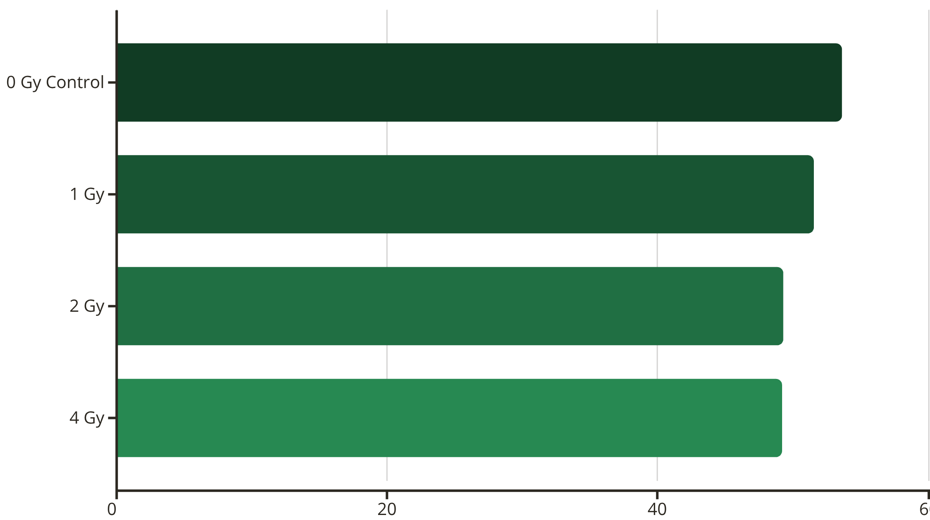
Experimental Results: DNA Protection vs. Sensitisation
DNA Alone (No Porphyrin)
Observation: Progressive decrease in Tm with increasing radiation dose, from 53.6°C at baseline to 49.2°C at 4 Gy, representing a 4.4°C depression. The melting interval ΔT remains relatively constant (~9.8-10.0°C), indicating uniform damage distribution.
Interpretation: Radiation-induced strand breaks destabilise the DNA double helix, reducing the thermal energy required for denaturation. The dose-dependent Tm reduction quantifies cumulative damage from both single-strand and double-strand breaks. This establishes the baseline radiation sensitivity of DNA in the absence of porphyrin modulation.
Notes:
При облучении чистой ДНК мы наблюдали прогрессивное снижение Tm с увеличением дозы излучения — от 53.6°C в контроле до 49.2°C при 4 Гр, что представляет собой снижение на 4.4°C.
Интерпретация: Радиационно-индуцированные разрывы цепей дестабилизируют двойную спираль ДНК, снижая тепловую энергию, требуемую для денатурации. Это устанавливает базовую радиационную чувствительность ДНК в отсутствие порфиринов.

Slide 12
Results: Concentration-Dependent Effects
r = 0.01 (Low Porphyrin Concentration)
Dose
Tm (°C)
ΔT (°C)
0 Gy
54.3
10.7
1 Gy
54.3
19.0
2 Gy
54.4
21.3
4 Gy
54.5
16.5
Key Finding: Tm remains essentially constant (54.3-54.5°C) across all radiation doses, in stark contrast to the 4.4°C decrease observed for DNA alone. The increased ΔT suggests some structural heterogeneity from partial protection.
Conclusion: TOEtPyP4 exerts a protective effect at low concentration (r = 0.01), maintaining DNA thermal stability despite radiation exposure.
r = 0.02 (Optimal Concentration)
Dose
Tm (°C)
ΔT (°C)
4 Gy
53.6
16.7
Key Finding: Decreased Tm (53.6°C, similar to unprotected DNA) combined with increased ΔT (16.7°C, broader transition) indicates a fundamentally different interaction regime.
Conclusion: At r = 0.02 with 4 Gy dose, an optimal combination for radiosensitisation is achieved. The porphyrin enhances rather than protects against radiation-induced DNA damage.
Notes:
Здесь начинается самое интересное.
При низкой концентрации порфирина (r = 0.01):
Tm остаётся практически постоянной (54.3-54.5°C) при всех дозах излучения, в резком контрасте со снижением на 4.4°C для чистой ДНК.
Вывод: TOEtPyP4 оказывает защитный эффект при низкой концентрации, поддерживая термическую стабильность ДНК несмотря на облучение.

Slide 13
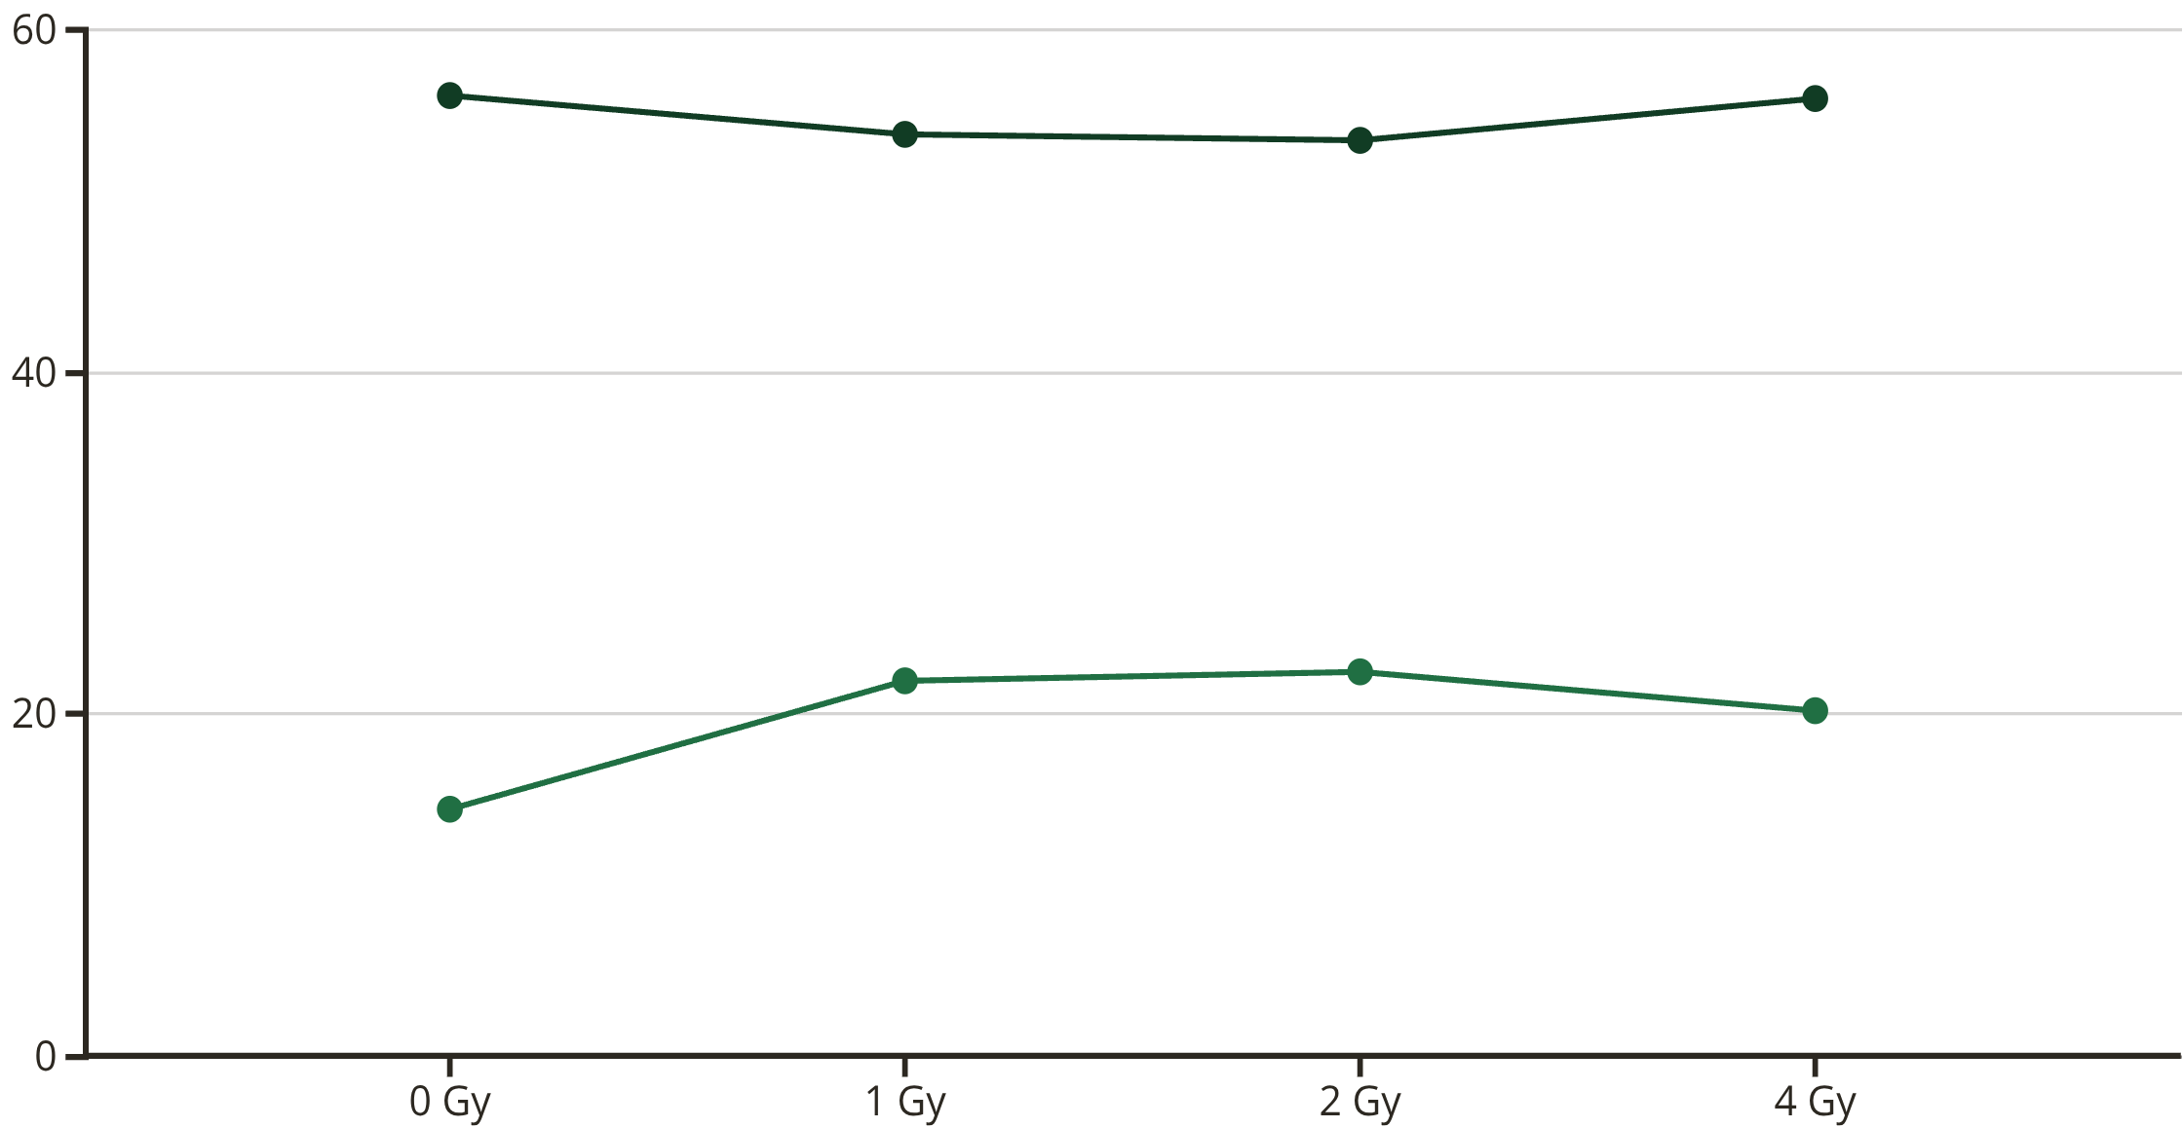
Results: High Concentration Effects
r = 0.04 (High Porphyrin Concentration)
Tm (°C)
ΔT (°C)
Key Finding: At 4 Gy dose, Tm increases back to 56.0°C, nearly matching the non-irradiated control (56.1°C). This remarkable recovery indicates that the protective effect returns at high porphyrin concentrations, even after substantial radiation exposure.
Conclusion: At high concentration (r = 0.04), porphyrins demonstrate a protective role, with excess porphyrin molecules scavenging free radicals more efficiently than they sensitise DNA to damage.
Dose-Dependent Melting Curves
Analysis of complete melting curves reveals clear concentration and dose-dependent behaviour. The system exhibits a biphasic response: protection at low concentrations (r = 0.01) and high concentrations (r = 0.04 at 4 Gy), with radiosensitisation at intermediate concentration (r = 0.02). This concentration window is critical for optimising therapeutic applications.
Notes:
При высокой концентрации (r = 0.04):
При 4 Гр Tm увеличивается обратно до 56.0°C, почти соответствуя необлучённому контролю (56.1°C).

Slide 14
Mechanistic Interpretation
Protective Effect Mechanism (r = 0.01, r = 0.04 at 4 Gy)
The protective behaviour observed at low and high porphyrin concentrations stems from the molecules' capacity to intercept and neutralise radiation-generated free radicals before they damage DNA. This radioprotection operates through complementary mechanisms:
ROS Scavenging
Physical Shielding
Porphyrins directly intercept hydroxyl radicals (•OH), superoxide (O₂⁻•), and other reactive species through electron transfer and addition reactions, converting them to less reactive forms.
Bound porphyrins create a physical barrier blocking radical access to DNA. The large planar porphyrin structure positioned on DNA surface intercepts diffusing radicals.
Electron Donation
Strand Stabilisation
Porphyrin can neutralise DNA radicals formed by direct ionisation through electron donation, repairing damage before strand breaks propagate.
Porphyrin binding increases DNA thermal stability through intercalation and electrostatic interactions, making the structure more resistant to radiation-induced destabilisation.
Binding mode: Likely external stacking and groove binding at these concentrations, maintaining DNA helical structure. Maintained Tm: The preservation of melting temperature across radiation doses indicates that the DNA double helix structure remains intact, confirming effective radioprotection.
Notes:
Защитное поведение, наблюдаемое при низких и высоких концентрациях порфирина, происходит от способности молекул перехватывать и нейтрализовать радиационно-генерированные свободные радикалы до того, как они повредят ДНК.
Механизмы радиопротекции:
Улавливание АФК — порфирины напрямую перехватывают гидроксильные радикалы, супероксид и другие реактивные формы
Физическое экранирование — связанные порфирины создают физический барьер, блокирующий доступ радикалов к ДНК
Донирование электронов — порфирин может нейтрализовать радикалы ДНК через донирование электронов
Стабилизация цепей — связывание порфирина увеличивает термическую стабильность ДНК

Slide 15
Radiosensitisation Mechanism (r = 0.02, 4 Gy)
How Porphyrins Enhance Radiation Damage
At the optimal intermediate concentration of r = 0.02, porphyrins switch from protecting DNA to amplifying radiation-induced damage. This radiosensitisation involves multiple synergistic mechanisms that concentrate and enhance the damaging effects of ionising radiation:
1
2
3
Localised ROS Generation
Secondary Electron Capture
Energy Transfer
Porphyrin molecules bound at DNA concentrate radical damage at critical sites. Radiolysis products are generated in immediate proximity to DNA, increasing hit probability.
Metal centres in porphyrin complexes enhance electron interactions through high cross-sections for low-energy electron capture, producing additional ionisation events.
Excited porphyrin states created by radiation energy deposition can transfer to DNA bases, inducing electronic excitations that lead to strand breaks.
4
5
Auger Electron Emission
Metal ions produce Auger electrons following inner-shell ionisation, creating dense ionisation tracks with high local damage density in nanometre-scale volumes.
Evidence: Decreased Tm indicates strand breaks and helix destabilisation. Increased ΔT reveals heterogeneous damage distribution with complex lesions. Optimal at r = 0.02, 4 Gy: This represents the ideal balance between porphyrin binding density and damage amplification, maximising radiosensitisation effect.
Notes:
Механизм радиосенсибилизации
При оптимальной промежуточной концентрации r = 0.02 порфирины переключаются от защиты ДНК к амплификации радиационно-индуцированного повреждения.
Механизмы включают:
Локализованная генерация АФК — молекулы порфирина, связанные с ДНК, концентрируют радикальное повреждение в критических местах
Захват вторичных электронов — металлические центры в порфиринах усиливают электронные взаимодействия
Перенос энергии — возбуждённые состояния порфирина могут переноситься на основания ДНК
Эмиссия оже-электронов — металлические ионы производят оже-электроны, создавая плотные треки ионизации

Slide 16



Concentration-Dependent Dual Role
The Porphyrin Concentration Paradox
High Concentration (r=0.04)
Intermediate Concentration (r=0.02)
Protective Effect Returns
Low Concentration (r=0.01)
OPTIMAL RADIOSENSITISATION
Protective Effect
Excess scavenging capacity. Unbound porphyrins in solution intercept radicals before reaching DNA, overcoming sensitisation effects.
Maximum damage enhancement achieved. Perfect balance between porphyrin binding density and ROS generation efficiency at DNA.
Scavenging dominates over sensitisation. Insufficient porphyrin density for efficient damage localisation, but adequate for radical interception.
Clinical Implications
Radioprotection Strategy
Radiosensitisation Strategy
Use r ≤ 0.01 or r ≥ 0.04 to protect normal tissues during radiotherapy. Pre-treatment with high-dose porphyrin systemically whilst lower concentrations accumulate preferentially in tumour/infection sites.
Use r = 0.02 with 4 Gy to selectively enhance tumour or bacterial killing. Precise concentration control enables differential effects between target and normal tissues, widening therapeutic window.
The therapeutic window critically depends on maintaining r = 0.02 at the target site whilst keeping r outside this range in surrounding healthy tissues.
Notes:
Концентрационно-зависимая двойная роль
Это парадокс концентрации порфирина:
Низкая концентрация (r=0.01): улавливание доминирует над сенсибилизацией
Промежуточная концентрация (r=0.02): ОПТИМАЛЬНАЯ РАДИОСЕНСИБИЛИЗАЦИЯ
Высокая концентрация (r=0.04): возвращается защитный эффект
Клинические последствия огромны. Мы можем использовать r ≤ 0.01 или r ≥ 0.04 для защиты нормальных тканей во время лучевой терапии, при этом поддерживая r = 0.02 в месте опухоли или инфекции для максимальной сенсибилизации.

Slide 17
Clinical Applications & Therapeutic Strategy
Target Indications
Photodynamic Mode
Radiation-Enhanced Mode
Porphyrins + 460 nm light
Porphyrins + electron/X-ray
Surface infections: Wounds, ulcers, burns with exposed tissue
Deep tissue infections: Osteomyelitis, abscesses, necrotising fasciitis
Accessible cavities: Oral, urinary, vaginal infections
Biofilm treatment: Catheter-related and device infections
Cancer-associated infections: Immunocompromised patients with opportunistic pathogens
Sterilisation: Medical devices, ex vivo tissue preparation
Combination radiotherapy: Tumour treatment with simultaneous infection prevention
MDR bacterial infections: Where conventional antibiotics have failed
The dual-mode capability enables clinicians to select the optimal activation method based on anatomical accessibility, tissue penetration requirements, and existing treatment infrastructure. Photodynamic therapy suits outpatient settings with superficial infections, whilst radiation-enhanced therapy integrates into oncology departments already equipped with radiotherapy facilities.

Slide 18
Advantages Over Current Therapies
Vs. Antibiotics
Vs. Conventional Radiation
No Resistance Development
Lower Doses Required
Multi-target, non-specific oxidative damage prevents adaptation. ROS attack multiple cellular components simultaneously.
Porphyrin sensitisation reduces radiation dose by 4-5 fold, minimising normal tissue toxicity whilst maintaining efficacy.
Broad Spectrum
Selectivity
Effective against all classes of microorganisms: Gram-positive, Gram-negative, fungi, viruses. No dependence on specific cellular targets.
Preferential porphyrin accumulation in bacterial cells or tumours provides target selectivity absent in radiation alone.
Biofilm Penetration
Tunable Effect
Physical agents (light, radiation) overcome extracellular matrix barriers that exclude antibiotics. ROS diffuse through biofilm structure.
Protection or sensitisation by concentration control: r ≤ 0.01 or r ≥ 0.04 for protection, r = 0.02 for sensitisation.
Rapid Action
Reduced Side Effects
Killing occurs within minutes to hours versus days for antibiotic therapy. Immediate inactivation reduces infection burden.
Targeted damage with radioprotection of normal tissues, expanding therapeutic window and improving safety profile.
Dual-Mode Flexibility
Same Compound, Different Activation
Adaptable to Clinical Setting
Combined Therapy Potential
Photodynamic or radiation modes using identical porphyrin, simplifying regulatory approval and clinical implementation
Light for accessible sites, radiation for deep tissues. Leverages existing infrastructure without specialised equipment
Sequential or simultaneous application of both modalities for maximum efficacy in complex infections
Notes:
Преимущества по сравнению с существующими методами лечения
В сравнении с антибиотиками
Отсутствие развития резистентности Многоцелевое неспецифическое окислительное повреждение предотвращает адаптацию. АФК атакуют множественные клеточные компоненты одновременно.
Широкий спектр действия Эффективны против всех классов микроорганизмов: грамположительные, грамотрицательные, грибы, вирусы. Не зависят от специфических клеточных мишеней.
Проникновение через биоплёнки Физические агенты (свет, излучение) преодолевают барьеры внеклеточного матрикса, которые исключают антибиотики. АФК диффундируют через структуру биоплёнки.
Быстрое действие Уничтожение происходит в течение минут-часов по сравнению с днями при антибиотикотерапии. Немедленная инактивация снижает инфекционную нагрузку.
В сравнении с традиционной лучевой терапией
Требуется более низкая доза Сенсибилизация порфирином снижает дозу излучения в 4-5 раз, минимизируя токсичность для нормальных тканей при сохранении эффективности.
Селективность Преимущественное накопление порфирина в бактериальных клетках или опухолях обеспечивает целевую селективность, отсутствующую при облучении без порфирина.
Настраиваемый эффект Защита или сенсибилизация путём контроля концентрации: r ≤ 0.01 или r ≥ 0.04 для защиты, r = 0.02 для сенсибилизации.
Снижение побочных эффектов Целенаправленное повреждение с радиопротекцией нормальных тканей, расширяющее терапевтическое окно и улучшающее профиль безопасности.

Slide 19
Prospects of Neutron Therapy in Antimicrobial Medicine
Concept of Neutron Therapy
Advantages for Antimicrobial Applications
Synergy with Porphyrin Sensitizers
Neutron therapy involves the use of fast neutrons for targeted energy deposition in biological tissues. Neutrons interact primarily with hydrogen nuclei, inducing dense ionization events that lead to more complex and less repairable DNA damage compared to photon or electron therapy.
High Linear Energy Transfer (LET): Neutrons exhibit high LET, leading to enhanced biological effectiveness against microbial cells, including those with inherent or acquired resistance.
Enhanced Neutron Capture: Porphyrins can be engineered to incorporate neutron-capturing elements (e.g., Boron-10, Gadolinium-157), leading to localized high-LET radiation release upon neutron irradiation (Neutron Capture Therapy).
Oxygen Enhancement Ratio (OER) Independence: Neutron therapy is less dependent on oxygenation, making it effective in hypoxic environments prevalent in deep-seated infections and biofilms where conventional treatments often fail.
Amplified Antimicrobial Effect: This targeted energy deposition can significantly amplify the damage to microbial cells, overwhelming their repair mechanisms and increasing eradication rates.
Deep Tissue Penetration: Fast neutrons can penetrate deep into tissues, making them suitable for treating infections located in inaccessible or shielded anatomical sites.
Targeted Delivery: Porphyrins' affinity for microbial cells or infected tissues can facilitate selective accumulation, improving specificity and minimizing toxicity to healthy host cells.
Clinical Aspects & Future Research Directions
Comparison with Conventional Radiation Therapy
Targeted Delivery Systems: Development of advanced delivery vehicles for neutron-sensitizing agents to ensure optimal concentration at infection sites.
Unlike conventional photon-based radiation therapy, neutron therapy offers superior biological effectiveness due to its high LET properties, allowing for more potent and less oxygen-dependent microbial killing. Its deep penetration and the potential for selective enhancement with sensitizers provide distinct advantages for treating complex and resistant infections that are unresponsive to current antimicrobial agents and traditional radiotherapy.
Dosimetry & Treatment Planning: Precise calculation of neutron dose distribution in heterogeneous tissues and rigorous treatment planning to maximize efficacy while ensuring patient safety.
Efficacy against AMR: Investigating the effectiveness of neutron therapy, particularly in combination with sensitizers, against multi-drug resistant (MDR) bacterial, fungal, and viral infections.
Integration with Standard Care: Exploring combined modalities with conventional antibiotics or surgical interventions to optimize patient outcomes.
Notes:
Нейтронная терапия с высоким ЛПЭ предлагает дополнительные возможности для лечения глубоких и резистентных инфекций. Синергия с порфириновыми сенсибилизаторами, содержащими нейтрон-захватывающие элементы, может значительно усилить антимикробный эффект.

Slide 20
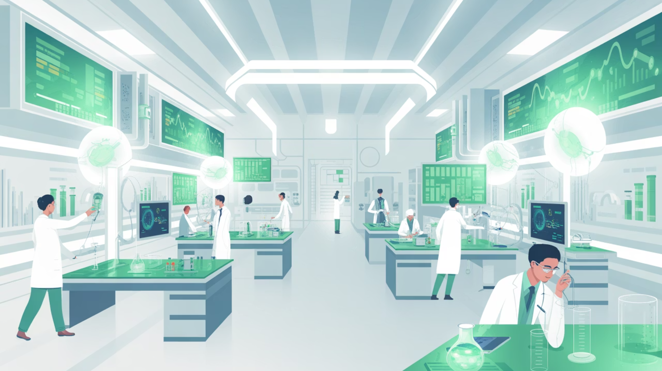
Thank you for your attention!

